Slide 1
ecommerce B2B data analysis
PRESENTED BY-
Ankit Kumar

Slide 2
INTRODUCTION
This project aims to perform exploratory data analysis (EDA) on an Ecommerce B2B dataset to identify customers that give the highest business and orders. By using data science skills to draw insights from real market data, we can help businesses focus on sectors that can increase revenue.
The dataset is a transnational data set containing all the transactions occurring between 01/12/2010 and 09/12/2011 for a UK-based and registered non-store online retail that mainly sells unique all-occasion gifts. The customers of the company are mostly wholesalers, both local and international.

Slide 3
Aim
To perform EDA on the Ecommerce dataset and find insights that can be helpful to identify the customers that gives highest business and orders.
We will be using data science skills to draw insights that happen in real markets and what sectors company need to focus to increase revenues.

Slide 4
Data Information
This is a transnational data set which contains all the transactions occurring between 01/12/2010 and 09/12/2011 for a UK-based and registered non-store online retail. The company mainly sells unique all-occasion gifts. Many customers of the company are wholesalers.
This dataset to begin with consists of transactional data and infers to customers from different countries who purchase from an online retail store based in the United Kingdom (UK) that sells gifts for all the occasions. The information is summarized below:
• Company – UK-based and registered non-store online retail
• Products for selling – Gifts for all occasions
• Customers – Most are wholesalers (local or international)
• The overall transaction period was one year

Slide 5
Dataset Description
Attributes
InvoiceNo: Invoice number. Nominal, a 6-digit integral number uniquely assigned to each transaction. If this code starts with letter 'c', it indicates a cancellation.
StockCode: Product (item) code. Nominal, a 5-digit integral number uniquely assigned to each distinct product.
Description: Product (item) name. Nominal.
Quantity: The quantities of each product (item) per transaction. Numeric.
InvoiceDate: Invoice Date and time. Numeric, the day and time when each transaction was generated.
UnitPrice: Unit price. Numeric, Product price per unit in sterling.
CustomerID: Customer number. Nominal, a 5-digit integral number uniquely assigned to each customer.
Country: Country name. Nominal, the name of the country where each customer resides

Slide 6
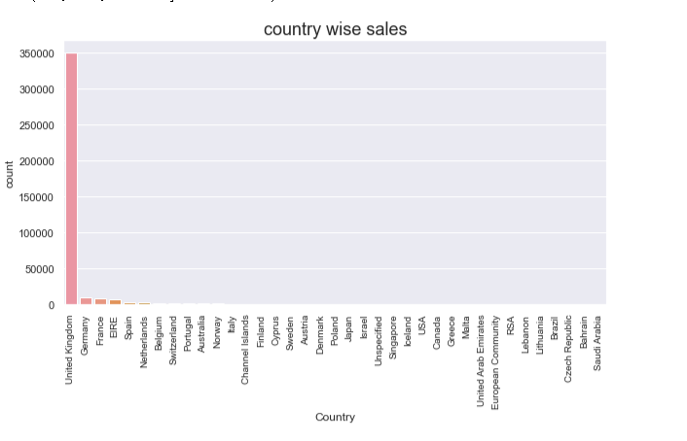
Data Analysis

Slide 7
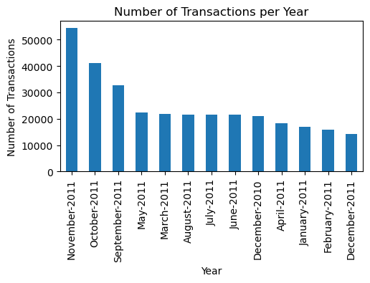
Data Analysis

Slide 8
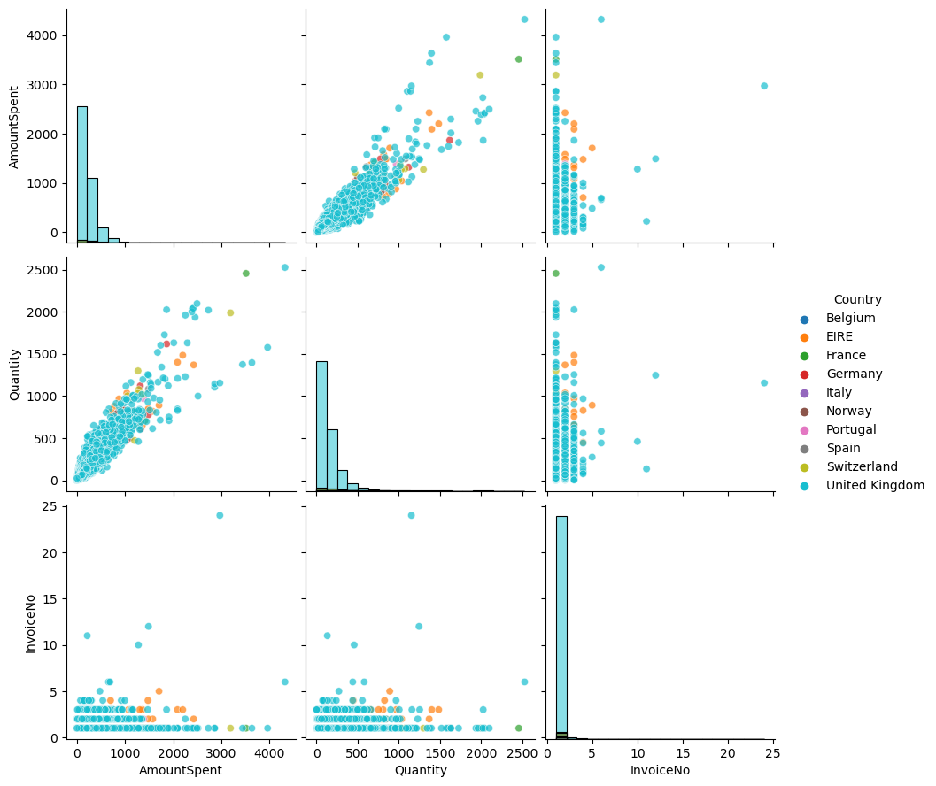
Data Analysis

Slide 9
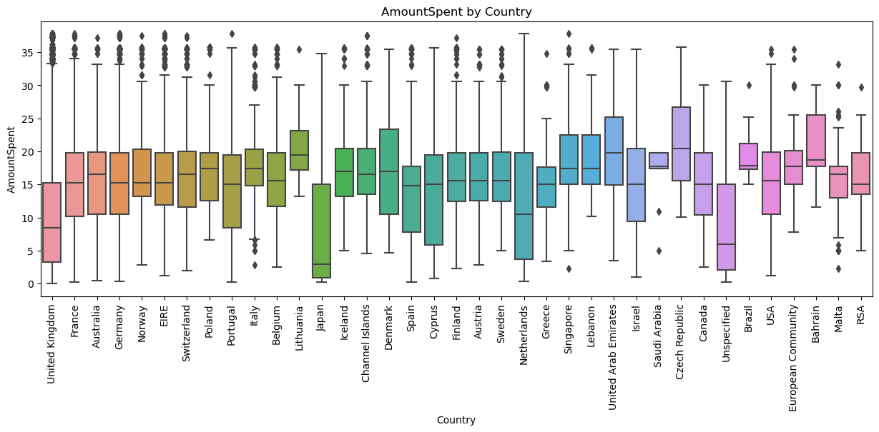
Data Analysis

Slide 10
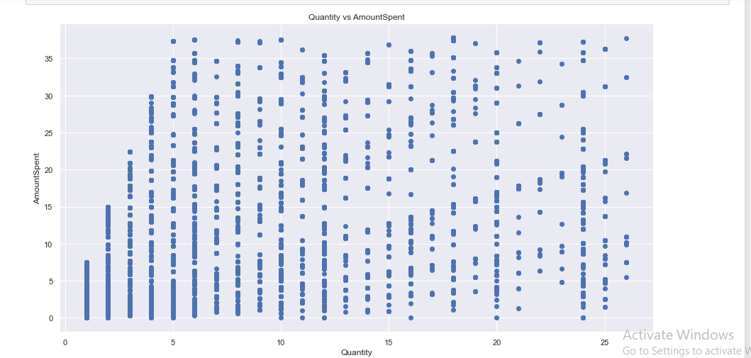
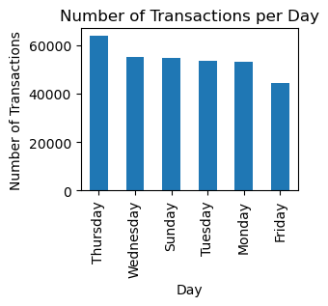
Data Analysis

Slide 11
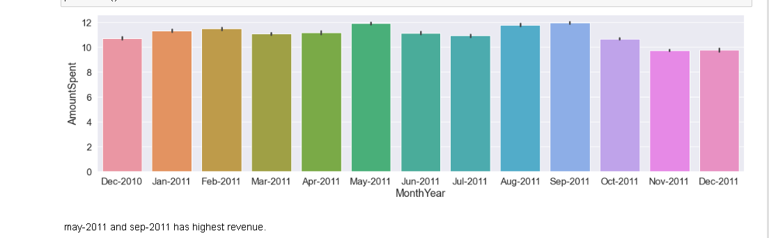
Data Analysis

Slide 12
CONCLUSION
United Kingdom Have Maximun Transaction
Saudi Arabia have minimum rvenue generated country
The Distribution Of Unit Price Is Right Skewed
In may-2011 and sep-2011 highest revenue generated
In November Month Maximun Transaction Performed
Maximun Number Of Transaction On Thursday
Overall, The Ecommerce B2b Dataset Shows A Clear Trend Towards Higher Transaction Volumes And Amounts Spent During The Holiday Season, Particularly In November And December. Additionally, Customers From Certain Countries Such As United Kingdom, France, Germany, Eire Tend To Spend More Per Transaction Across Multiple Product Categories. It Is Recommended That The Company Focus On Increasing Sales During The Holiday Season And Targeting Customers From These Countries To Increase Revenue.

Slide 13
THANK YOU…!

